Slide 1

RISC-V PROCESSOR: ARCHITECTURE AND ITS APPLICATION
B.Tech (ECE)
Presented by:
Suryansh Shukla
Department of Electronics and Communication Engineering,
Madan Mohan Malaviya University of Technology, Gorakhpur (UP) , India

Slide 2
Outline of Presentation
Introduction
Literature Review
Methodology And Technical Details
Applications
Future Work
Conclusion
References

Slide 3
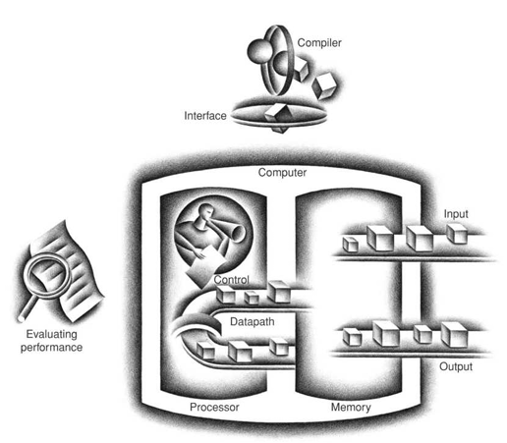
Introduction
1.1 Introduction to microprocessor
Electronic programmable computing device
Executes stored program instructions
Performs arithmetic and logic
Controls system operations
Central Processing Unit (CPU)
1.2 Evolution of Instruction Set Architecture
Early simple processors
Introduction of CISC architecture
Development of RISC concept
Need for performance improvement
Emergence of open ISAs
Figure 1: The organization of a computer, showing the five classic components.
Source: Computer Organisation and Design, David A. Patterson, John L. Hennessy, 2018

Slide 4
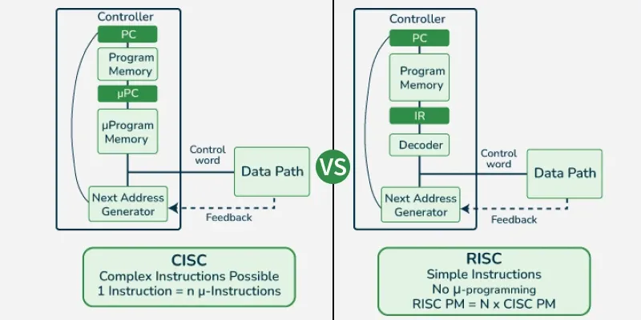
1.3 CISC vs RISC Architecture
Complex vs simple instructions
Variable vs fixed length
Memory-to-memory vs load-store
Fewer vs more registers
Performance and power comparison
1.4 Need for Open Instruction Set
Reduce licensing cost
Encourage innovation
Academic research support
Custom processor development
Industry flexibility
Figure 2: CISC VS RISC
Source: Processor Architecture Design Practices: survey & Issues SADHNA K. MISHRA, ARVIND RAJAWAT, R.P. SINGH,2010

Slide 5
1.5 Introduction to RISC Architecture
Reduced Instruction Set Computer
Simple fixed-length instructions
Load-store based design
Efficient pipelining
High performance and efficiency
1.6 Motivation
Growing demand for customization
Limitations of proprietary ISAs
Need for scalable architecture
Industry shift toward openness
1.7 Objectives
Understand ISA fundamentals
Compare CISC and RISC
Study RISC-V architecture
Analyze extensions and applications

Slide 6
Literature Review
History of RISC
RISC concept introduced in 1980s
Focus on simple instructions
Improved pipeline efficiency
Reduced hardware complexity
Foundations for modern ISAs
S. No. | Paper Title | Authors | Year | Institution / Journal | Key Contribution
1 | The Case for the Reduced Instruction Set Computer | David A. Patterson, David R. Ditzel | 1980 | ACM SIGARCH | Introduced RISC concept; argued simpler instructions improve performance via pipelining.
2 | RISC I: A Reduced Instruction Set VLSI Computer | David A. Patterson, Carlo H. Sequin | 1981 | UC Berkeley | Demonstrated load–store architecture and fixed-length instruction benefits.
3 | MIPS: A Microprocessor Architecture | John L. Hennessy | 1982 | Stanford University | Introduced pipeline optimization and compiler-based scheduling.

Slide 7
Research Development
RISC-V introduced in 2010
Open source ISA model
Rapid academic adoption
Industry collaboration growth
Expansion through extensions
S. No. | Paper Title | Authors | Year | Institution / Journal | Key Contribution
1 | The RISC-V Instruction Set Manual, Volume I: User-Level ISA | Andrew Waterman, Krste Asanović | 2011 | UC Berkeley | Introduced open, modular, royalty-free ISA architecture.
2 | A Survey of RISC-V Architecture and Its Applications | Yun sup Lee | 2019 | IEEE Access | Analysed industrial adoption, AI extensions, IoT applications, scalability.

Slide 8
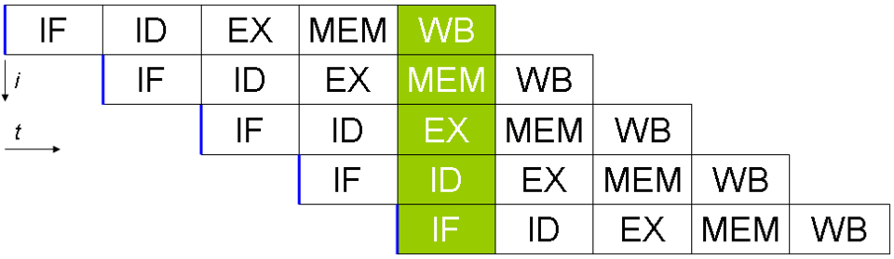
Methodology and Technical Details
1.1 RISC-V Architecture
Design Philosophy
Simple fixed-length instructions
Load–store architecture model
Modular base-plus-extension design
Open and royalty-free ISA
Scalable 32/64/128-bit support
Reduced hardware complexity
5 stage efficient pipelined execution
32 general-purpose register set (x0 – x31)
No condition code registers
Custom instruction extensibility through extensions
Figure 3: 5 stage pipeline in RISC V
Source: Processor Architecture Design Practices: survey & Issues SADHNA K. MISHRA, ARVIND RAJAWAT, R.P. SINGH,2010

Slide 9
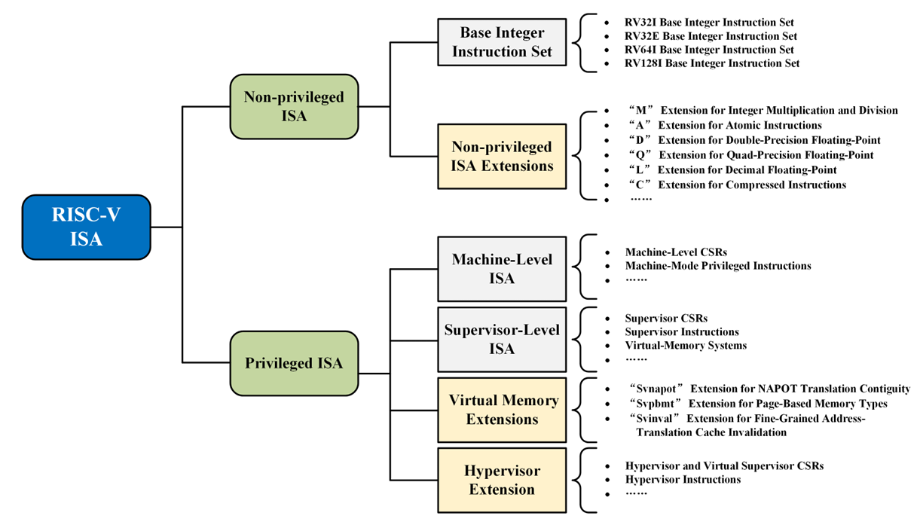
RISC-V ISA
Figure 4: RISC-V ISA
Source: RISC-V Instruction Set Architecture Extensions: A Survey ENFANG CUI , (Member, IEEE), TIANZHENG LI, AND QIAN WEI), 2023

Slide 10
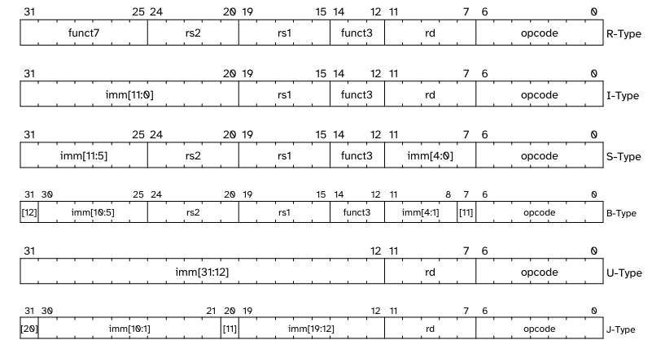
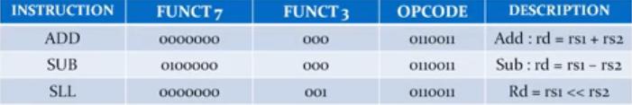
RISC-V Instructions
R-Type – Register to Register
I-Type – Immediate Operations
S-Type – Store Instructions
B-Type – Branch Instructions
U-Type – Upper Immediate
J-Type – Jump Instructions
opcode – Defines instruction class
rd – Result register index
rs1 – Operand 1 register
rs2 – Operand 2 register
funct3 – ALU control bits
funct7 – Additional operation bits
imm – Encoded constant operand
Figure 5: Different types of instruction and its format in RISC V
Source: The RISC-V Instruction Set Manual Volume I Unprivileged Architecture Version 20250508, 2019

Slide 11
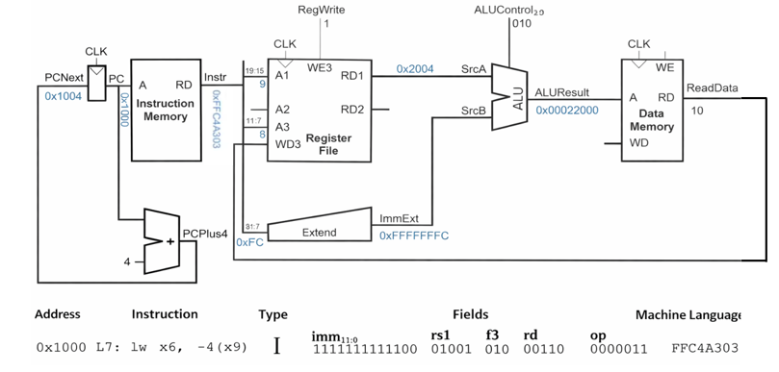

RISC-V Datapath Example
Figure 6: Load Instruction, Single Cycle Datapath
Source: A. Waterman, Y. Lee, D. A. Patterson, and K. Asanović, “The RISC-V Instruction Set Manual, Volume I: Unprivileged ISA”,
Adapted from: Sarah Harri, https://www.youtube.com/watch?v=AoBkibslRBM, 2022
-4 | x9 | 010 | x6 | 0000011

Slide 12
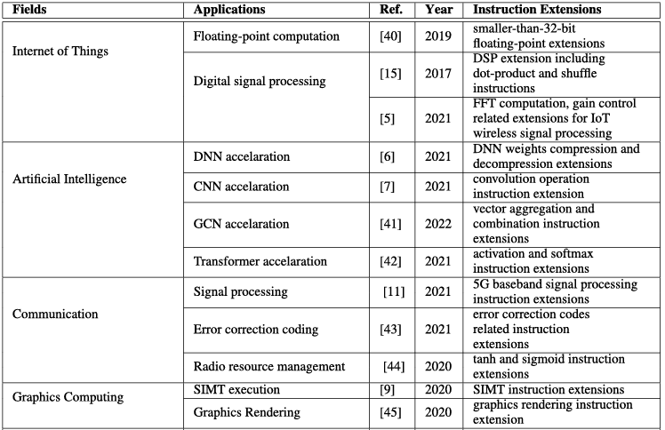
RISC-V Extensions
M – Integer Multiplication & Division
A – Atomic Memory Operations
F – Single Precision Floating Point
D – Double Precision Floating Point
C – Compressed 16-bit Instructions
V – Vector Processing Support
B – Bit Manipulation Operations
H – Hypervisor Extension
Example: IoT → RV32I + C Server → RV64I + M + A + F + D
Features of Extensions
Modular design approach
Custom extension capability
Scalable performance enhancement
ISA flexibility support
Application-specific optimization
Figure 7 :Categorization of RISC-V ISA extension works
Source:RISC-V Instruction Set Architecture Extensions: A Survey ENFANG CUI , (Member, IEEE), TIANZHENG LI, AND QIAN WEI, 2023

Slide 13
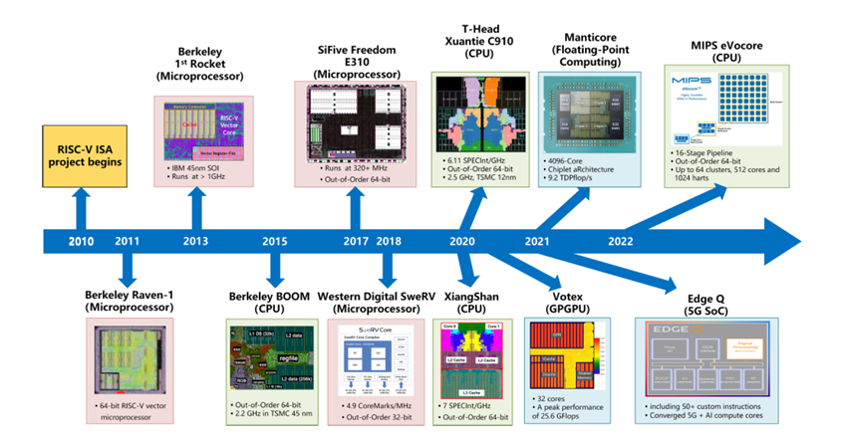
Applications
Embedded systems design
IoT devices and sensors
Microcontrollers (MCU based systems)
Edge computing devices
AI/ML accelerators
Automotive control systems
Industrial automation systems
Consumer electronics products
FPGA based processors
Custom SoC development
Figure 8 :Application of RISC-V ISA over time
Source:RISC-V Instruction Set Architecture Extensions: A Survey ENFANG CUI , (Member, IEEE), TIANZHENG LI, AND QIAN WEI ), 2023

Slide 14
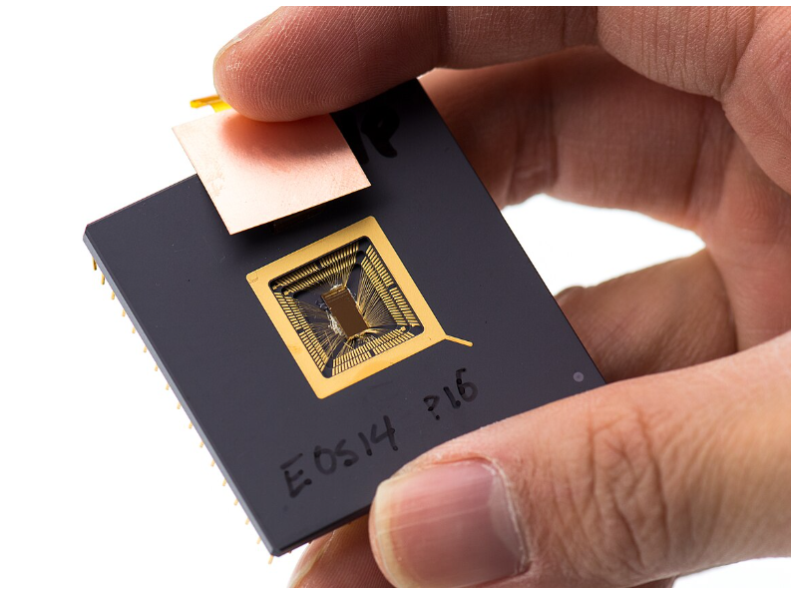
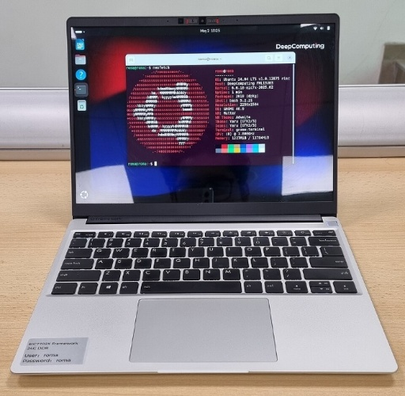
Advantages and Limitations
Advantages of RISC-V
Open-source ISA architecture
No licensing cost
Modular extension support
Custom instruction flexibility
Simple instruction format
Efficient pipelined execution
Scalable (32/64/128-bit)
Strong academic adoption
Limitations of RISC-V
Smaller software ecosystem
Limited legacy support
Fewer mature toolchains
Industry adoption growing
Optimization still evolving
Compatibility challenges
Figure 9 Yunsup Lee holding RISC V prototype chip. At UC Berkeley Par Lab Winter Retreat, January 2013.
Source: Wikipedia , February 2026 https://www.flickr.com/photos/dcoetzee/8694597164/
Figure 10: Framework Laptop 13 containing DC-ROMA RISC-V AI PC motherboard running Ubuntu 24.04, showing neofetch output
Source: Wikipedia , February 2026 https://upload.wikimedia.org/wikipedia/commons/thumb/8/84/DC_ROMA_AI_PC_Framework_Laptop_13_Ubuntu.jpg/960px-DC_ROMA_AI_PC_Framework_Laptop_13_Ubuntu.jpg

Slide 15
Future Work
Custom ISA extensions for AI/ML
Vector (V) extension optimization
Low-power IoT processor design
Secure boot & hardware security
FPGA prototyping and validation
Compiler and toolchain enhancement
Multi-core & heterogeneous SoC integration

Slide 16
Conclusion
RISC-V is open-standard ISA
Based on RISC principles
Modular base + extensions
Simple and efficient design
Supports customization
Scalable 32/64/128-bit
Growing industry adoption
Strong future potential

Slide 17
References
[1] D. A. Patterson and D. R. Ditzel, “The Case for the Reduced Instruction Set Computer,” ACM SIGARCH Computer Architecture News, vol. 8, no. 6, pp. 25–33, 1980.
[2] D. A. Patterson, Carlo H. Sequin, “RISC I: A Reduced Instruction Set VLSI Computer,” Proceedings of ISCA, 1981.
[3] A. Waterman and K. Asanović, The RISC-V Instruction Set Manual, Volume I: Unprivileged ISA, University of California, Berkeley, 2011–2023.
[4] Y. Lee., “A Survey of RISC-V Architecture and Its Applications,” IEEE Access, vol. 7, pp. 100101–100120, 2019.
[5] D. A. Patterson and J. L. Hennessy, Computer Organization and Design: RISC-V Edition, Morgan Kaufmann, 2017.
[6] E. Cui, T. Li, and Q. Wei, “RISC-V Instruction Set Architecture Extensions: A Survey,” IEEE Access, 2022

Slide 18
THANK YOU

